Slide 1
Appalachia’s Bright Future
Harlan Center
April 20 , 2013

Slide 2
Enabling Technology.
Empowering People.

Slide 3
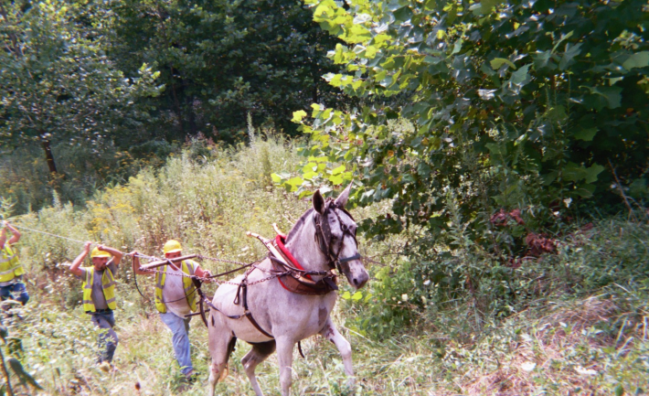

Slide 5
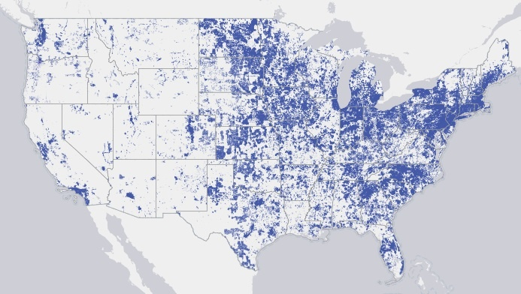
Nationwide
98% - 3 Mbps download
65-70% - subscribe
70 million offline
Kentucky
95% - 3 Mbps download
Harlan County
54% - 3 Mbps download

Slide 6
The National Broadband Plan, released in 2010 by the Federal Communications Commission
1. At least 100 million U.S. homes should have affordable access to 100 Mbps download
2. The United States should lead the world in mobile innovation
3. Every American should have affordable access to robust broadband service and the means and skills to subscribe if they so choose.
4. Every American community should have affordable access to at least 1 gigabit per second broadband service to anchor institutions such as schools, hospitals, and government buildings.
5. Every first responder should have access to a nationwide, wireless, interoperable broadband public safety network.
6. To ensure that America leads in the clean energy economy, every American should be able to use broadband to track and manage their real-time energy consumption.
To learn more, visit: www.broadband.gov

Slide 8
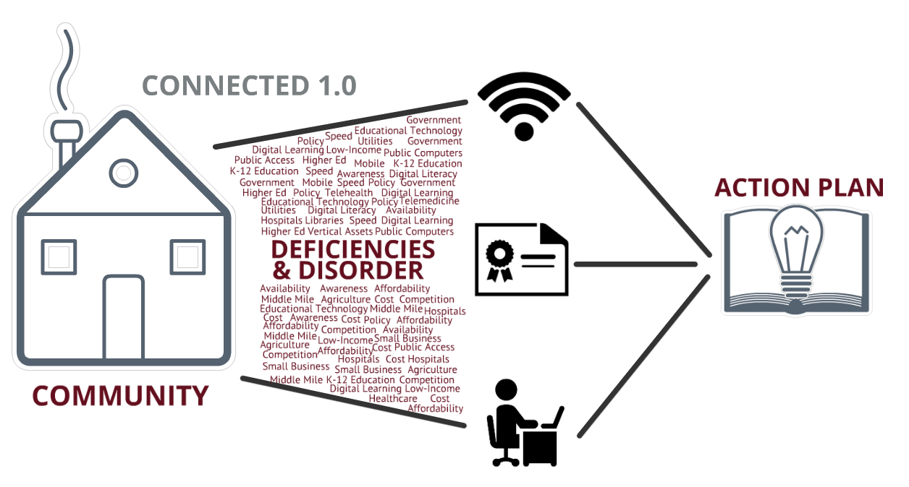
ACCESS
ADOPTION
USE

Slide 9
ALL SOLUTIONS ARE LOCAL
(STOP) COLLABORATE & LISTEN METHODOLOGY
Aggregate Local Experience
Assess Broadband Environment
Assess & Aggregate Demand
Assess Existing Assets & Solutions

Slide 10
AGGREGATE LOCAL EXPERIENCE
Develop a local public-private planning team
Organize planning meetings
Collect data (access, adoption, use)
Prioritize projects
Who’s on the team?
Elected officials
Representatives from healthcare, education, economic development
Community activists
Business leaders
Small business owners
Local service providers
IT directors
Representatives of minority groups
We provide a third party facilitator to provide focus and an organized process. The Connected Assessment, based on the National Broadband Plan, provides a framework for measuring the local broadband ecosystem.

Slide 11
ASSESS BROADBAND ENVIRONMENT
What technologies are in place?
Last mile availability
Middle mile infrastructure
Competition
Speed of service
Mobile broadband availability
What about community anchor institutions?
Schools
Libraries
Fire departments
Police stations
Local government
Community non-profits
Connected Nation’s GIS and Mapping Services team provides this data, and works with communities to confirm data.

Slide 12
AGGREGATE DEMAND & ASSESS BARRIERS
Aggregate Demand
What services are currently being purchased?
What do residents and businesses need, and what are they prepared to pay?
Determine best estimates of take rates in businesses, public, and residential markets
Determine the range of products and pricing that will ensure best take rate
Assess Barriers to Adoption
What are the barriers to home broadband subscription?
Digital literacy
Relevance
Affordability
Access
Connected Nation’s Research team can assist with local survey design, and our Connected Assessment identifies gaps and solutions for overcoming barriers.

Slide 13
ASSESS EXISTING ASSETS & SOLUTIONS
Assess Existing Infrastructure
Which facilities offer public access or could support training?
What technology and vendor mix will deliver the best solution for the community?
Technology partners that can contribute to aggregate demand?
What is already in place that could be applied to a network thus minimizing capital expenditure for new network?
The Connected Portal helps organize local resources. Connected Nation also offers asset mapping and can help facilitate public-private partnerships.

Slide 14
“Well, I’ve got a backhoe in the barn….”

Slide 15
RESOURCES & SOLUTIONS
USDA grants and loans
Develop a public-private partnership
Reassess major telecom purchases, develop RFP for build-out
Municipal broadband network
Barbourville, Glasgow, Russelville
Review local policies and rights of way for middle mile
Property owners with vertical assets can partner with telecom companies seeking to expand wireless networks
MOST IMPORTANTLY:
1. Develop a team
2. Identify assets and needs
3. Develop a plan

