Slide 1
Cultural Organizing: Growing the Resistance Through Art, Story, and Belonging
KFTC Cultural Organizing Team
Presenters: LeTonia Jones, MSW
Dr. Bonifacio Aleman

Slide 2
Welcome
Introductions
Purpose of Workshop

Slide 3
Intention:
To discuss how culture shapes power and organizing.

Slide 4
Session Flow
Share our vision
Define Cultural Organizing
Cultural Artifacts and Reflection
Next Steps
Close

Slide 5
Our Vision
We have a vision …
We are working for a day when Kentuckians – and all people – enjoy a better quality of life. When the lives of people and communities, matter before profits. When our communities have good jobs that support our families without doing damage to the water, air, and land. When companies and the wealthy pay their share of taxes and can’t buy elections. When all people have health care, shelter, food, education, and other basic needs. When children are listened to and valued. When discrimination is wiped out of our laws, habits, and hearts. And when the voices of ordinary people are heard and respected in our democracy.

Slide 6
What is Cultural Organizing?
Cultural organizing is a strategic approach to movement-building that places culture—our art, stories, rituals, symbols, and shared memories—at the very center of how we shift power and sustain collective action. At its heart, cultural organizing:

Slide 7
Some Principles of Cultural Organizing
Values Meaning over Mere Mechanics
Rather than treating art, music, or storytelling as “extras” layered on top of policy or protest, cultural organizing weaves them into every step of an organizing campaign—so that people connect with one another, and with shared purpose, at a visceral, emotional level.
Draws on Ancestral and Community Wisdom
It honors the knowledge held in traditions, ceremonies, oral histories, and local practices—recognizing that movements rooted in lived culture carry deeper resonance and stay power.
Creates Shared Symbols and Narratives
By co-creating images, songs, rituals, or artifacts, groups forge common language and identity that expand who feels welcome and who feels moved to act.

Slide 8
Principles of Cultural Organizing continued
Invites Participatory Storytelling
Every person holds a piece of the story—when we surface personal and collective narratives in circles, murals, performances, or digital media, we strengthen solidarity and imagine new futures together.
Sustains Joy, Resilience, and Imagination
Culture fuels hope. It provides moments of celebration, rest, and visioning that recharge organizers and communities—so we don’t burn out, but instead build resistance rooted in joy.

Slide 9
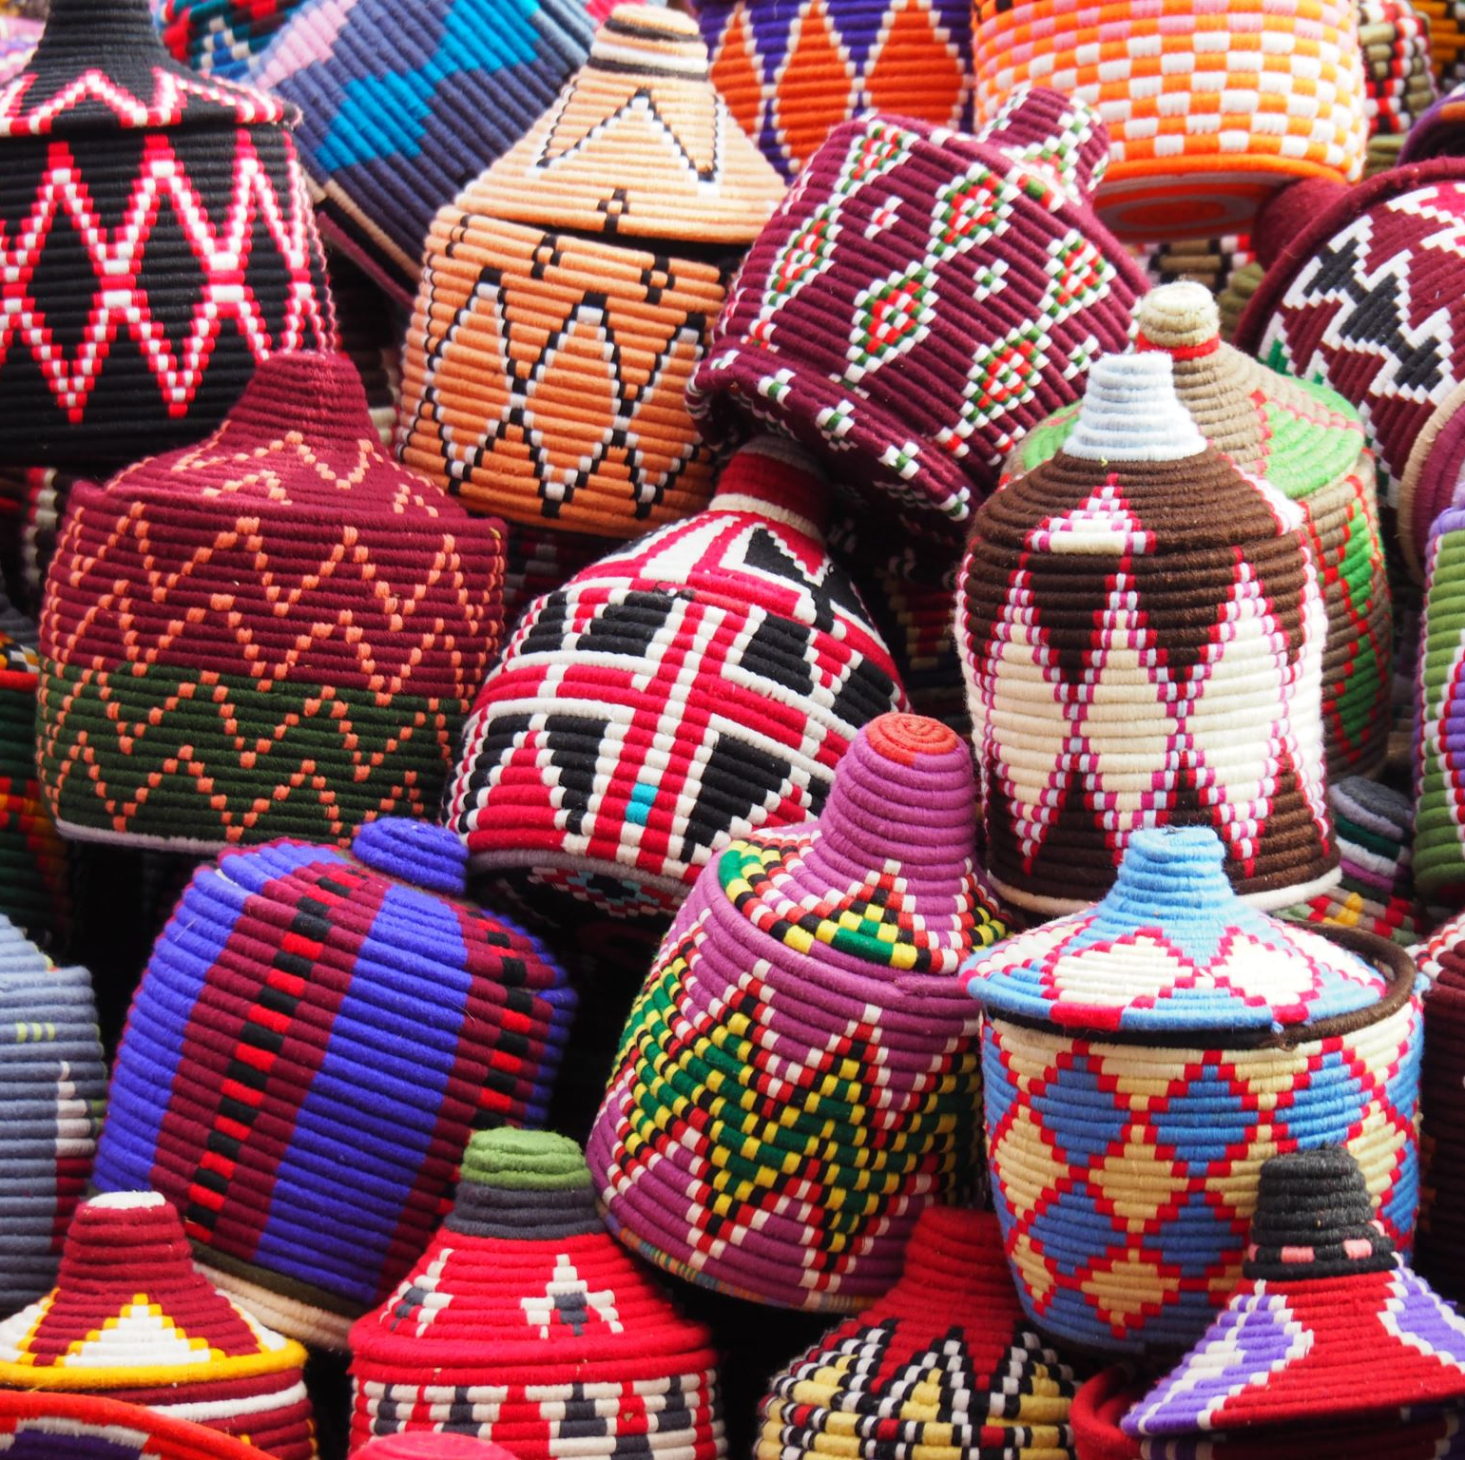
Why Cultural Organizing Matters

Slide 10
Cultural Organizing has the power to:
Deepen Engagement: People move from “I support this cause” to “I belong to this movement.”
Expand Reach: Cultural work opens doors to new audiences and allies who connect first with story and art.
Strengthen Resilience: Rituals and collective memory anchor us when tactics or leadership change—culture carries us forward.

Slide 11
Examples in Practice
Artifact Circles: Sharing a regional object (a quilt patch, a tool, a photograph) to surface stories of migration, struggle, and hope, then knitting those stories into a public mural or digital archive.
Songwriting Workshops: Co-creating protest or affirmation songs that amplify local demands while weaving in ancestral chants or melodies.
Site Rituals: Designing brief ceremonies before an action—lighting candles, drumming, or offering guided meditations—to center participants’ intentions and build collective focus.

Slide 12
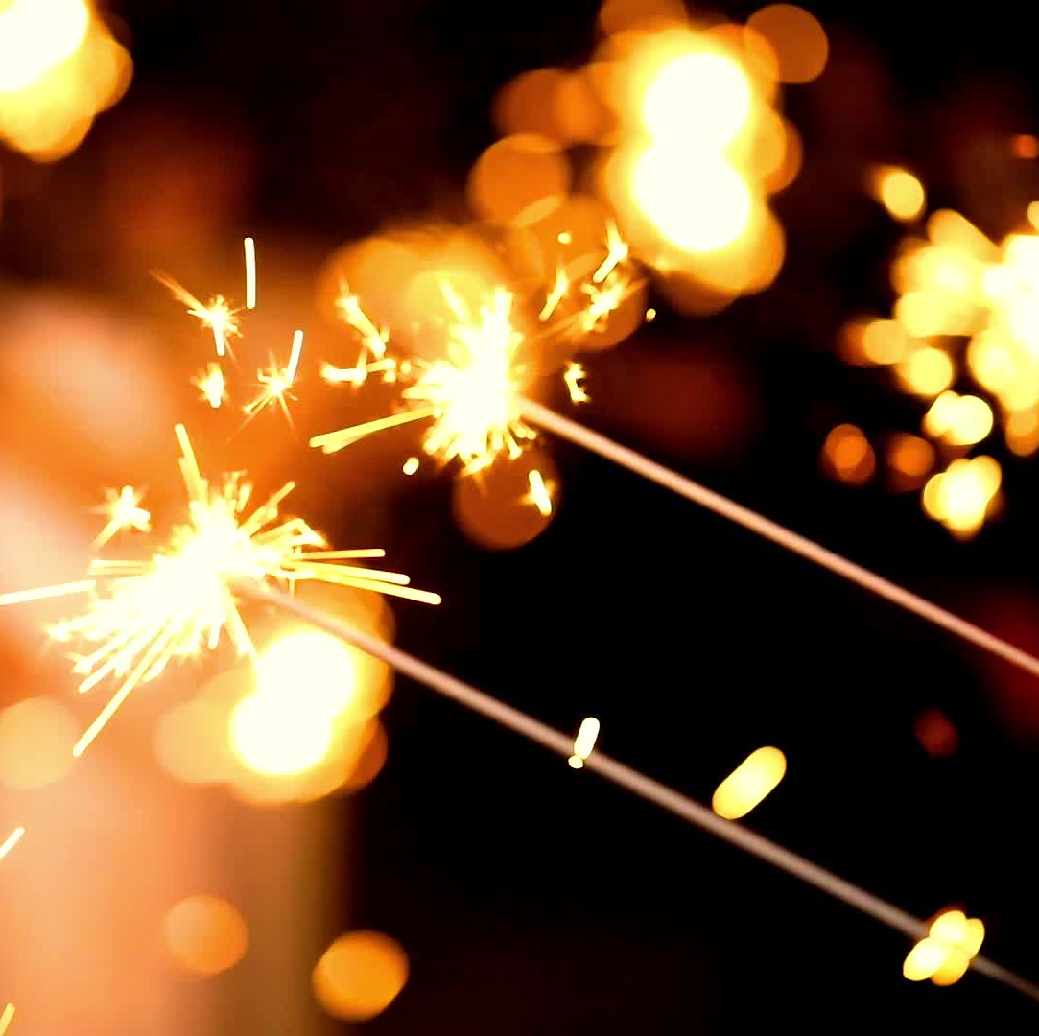
Let’s Play

Slide 13
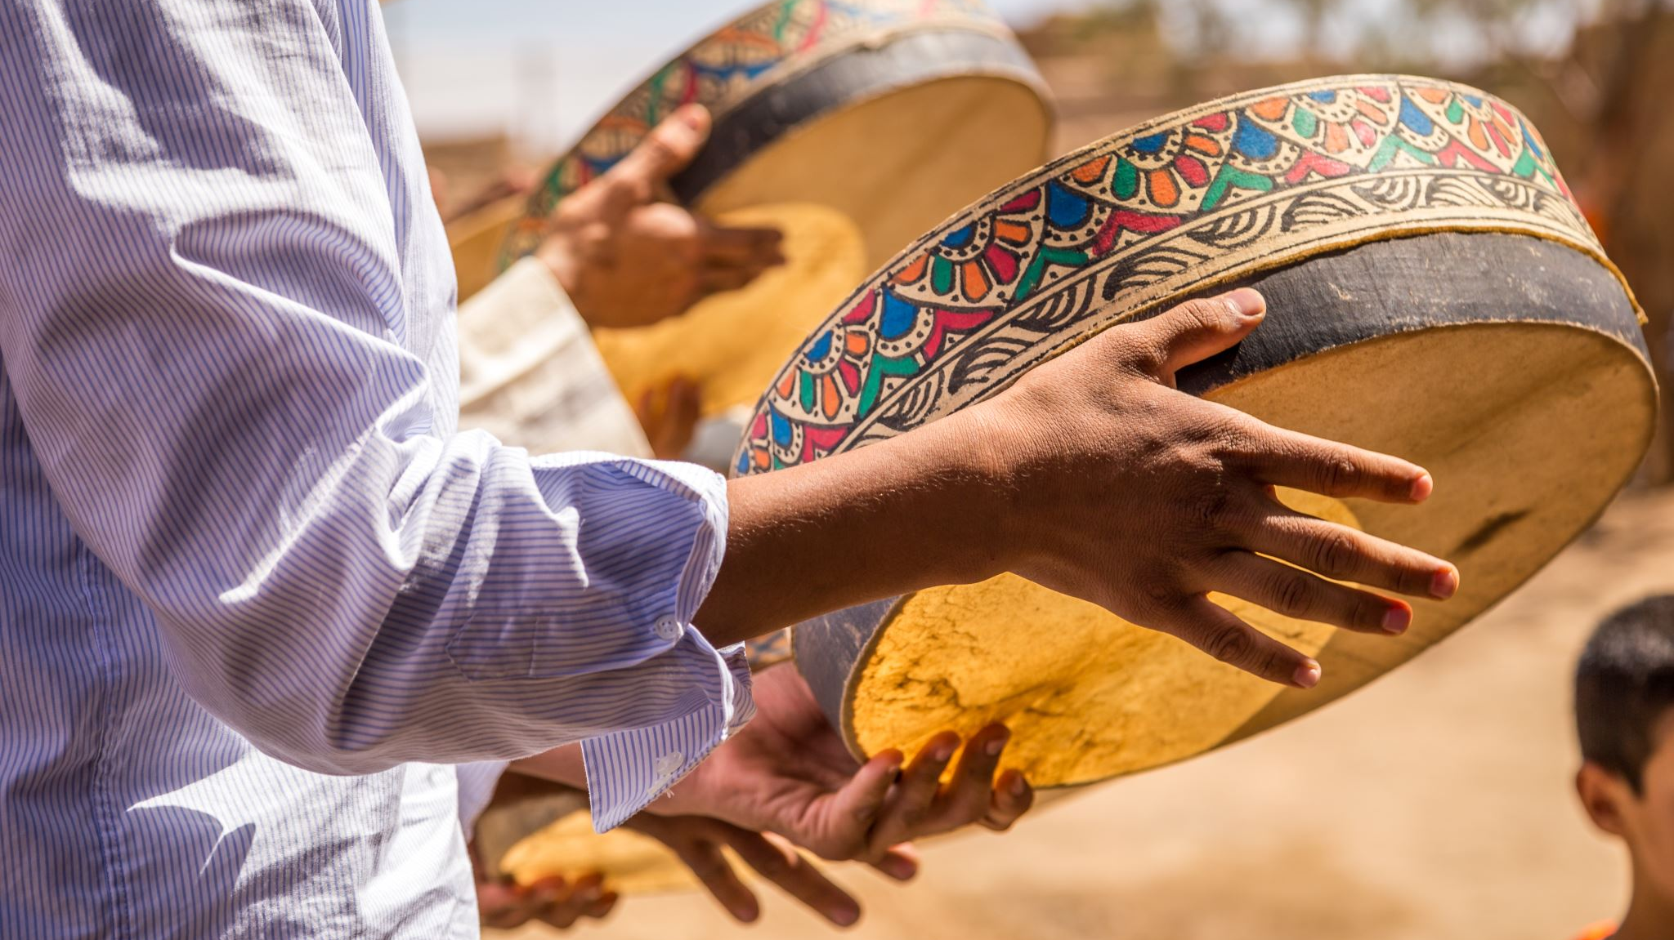
Cultural Artifact Activity

Slide 14
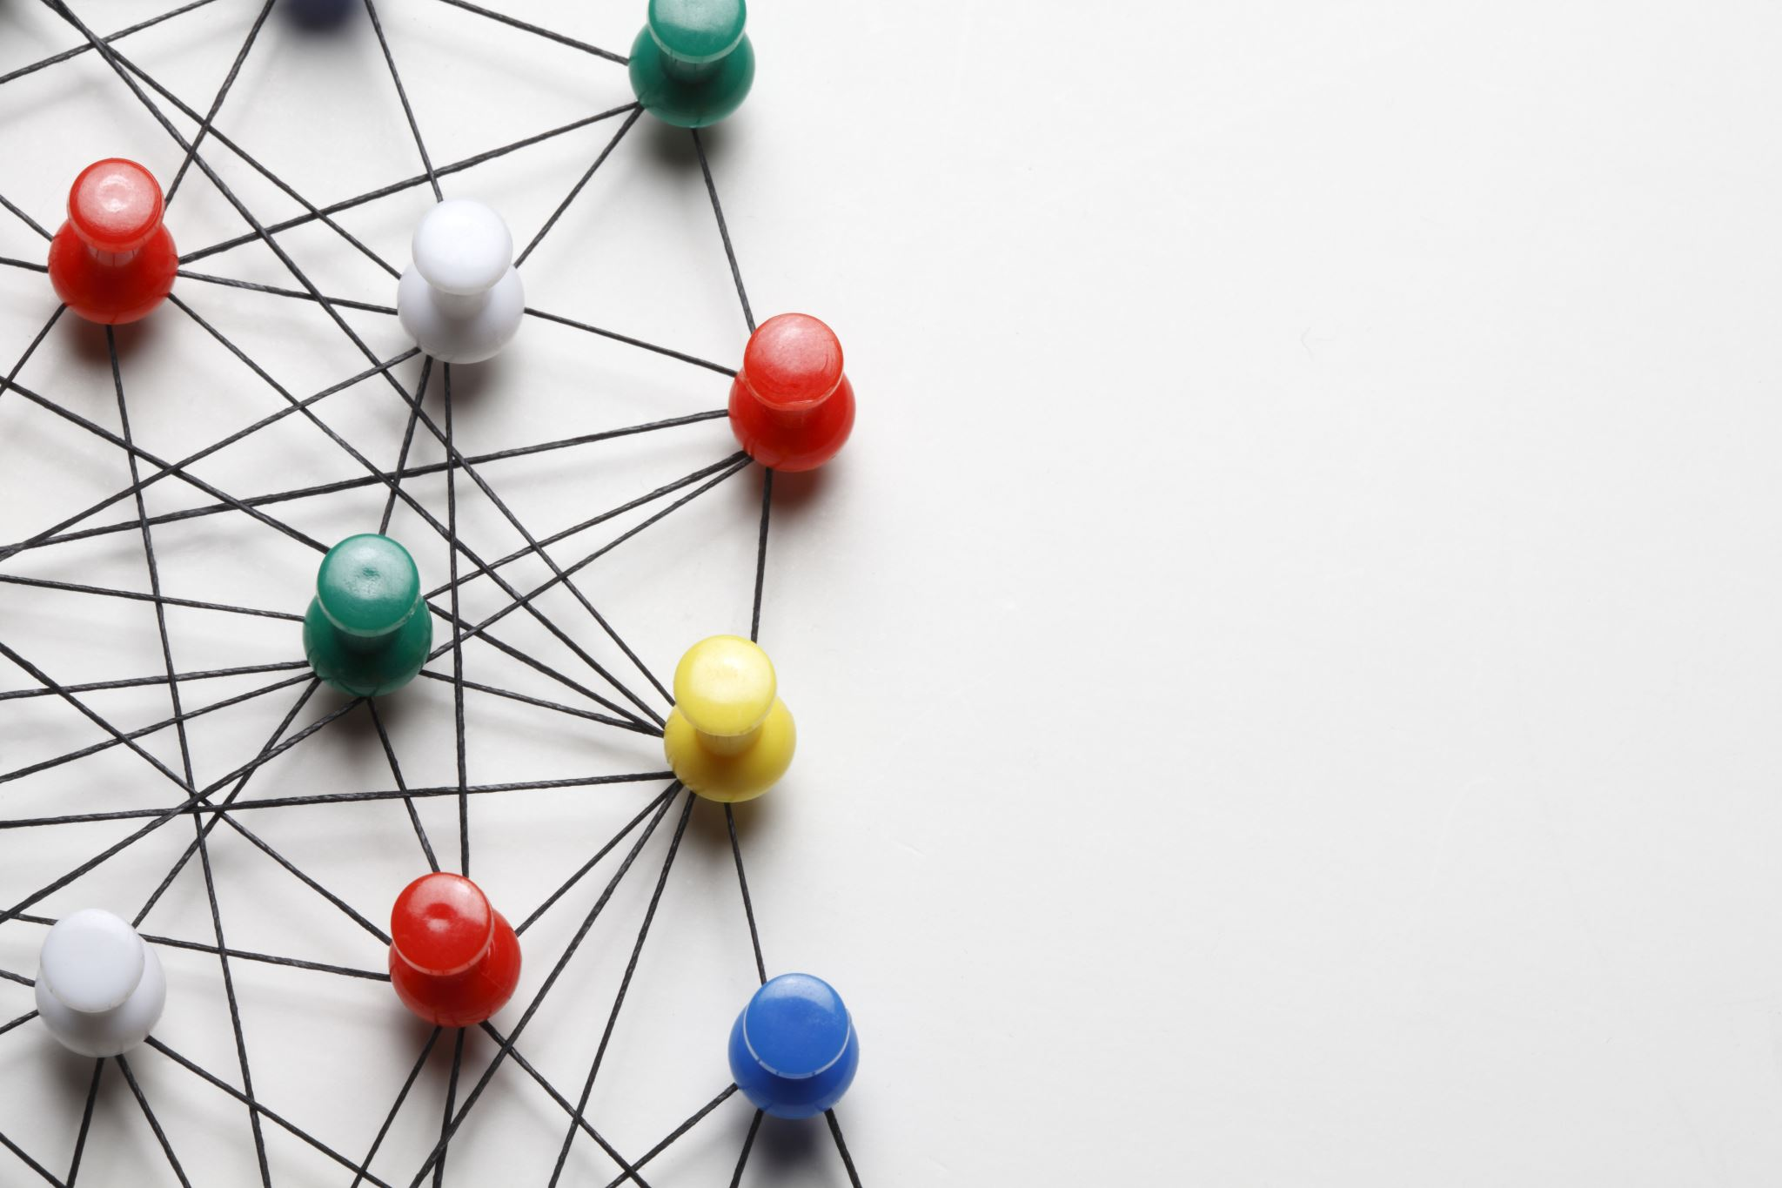
Instructions
Form small groups
Introduce or talk about an artifact from your area (4 mins)
With an Artifact: Each person holds up their object and shares:
  What is it?
  Where did you get or inherit it?
  One sentence on why it matters to your community’s story.
In the same circle, each person picks one question to expand their share:
  What memory or emotion does this object evoke?
  How has this object ‘witnessed’ struggle or celebration?
  If this object could speak, what wisdom would it offer us?

Slide 15
Instructions continued
As a group, identify 1–2 common themes or surprising connections.
Jot them down
Discuss:
“How might we transform these shared themes into a cultural project?”
Mural? Story circle? Digital archive? Performance?
Choose one concrete idea and prepare to share with full group.

Slide 16
Instructions
Without an Artifact: (choose one of the suggestions)
  Name an object—real or imaginary—that symbolizes resilience in your region.
  Think of a traditional tool or craft from your community.
  Recall a family heirloom or local landmark.

Slide 17
Sketch/Describe
On paper draw or name your brainstormed artifact.
1
Describe what it looks like and where it “lives.”
Use It in a Project
2
Imagine how your brainstormed artifact could anchor a mural, story circle, or ritual.

Slide 18
Share with larger group
  Offer a 30-sec to 1 min highlight:
    Artifact theme + project idea.

Slide 19
Dreaming Together: Building with Cultural Organizing
How do you think you can integrate cultural organizing work into your chapter’s work?
What are some areas of support you imagine you may need?
What could you see as a next step for your chapter toward cultural organizing?

Slide 20
Next Steps
Key Take Aways
Discuss Timeline for Completion
Get Involved
Refer to action page/QR code to join the COT workgroup
Date and time of next meeting

Slide 21
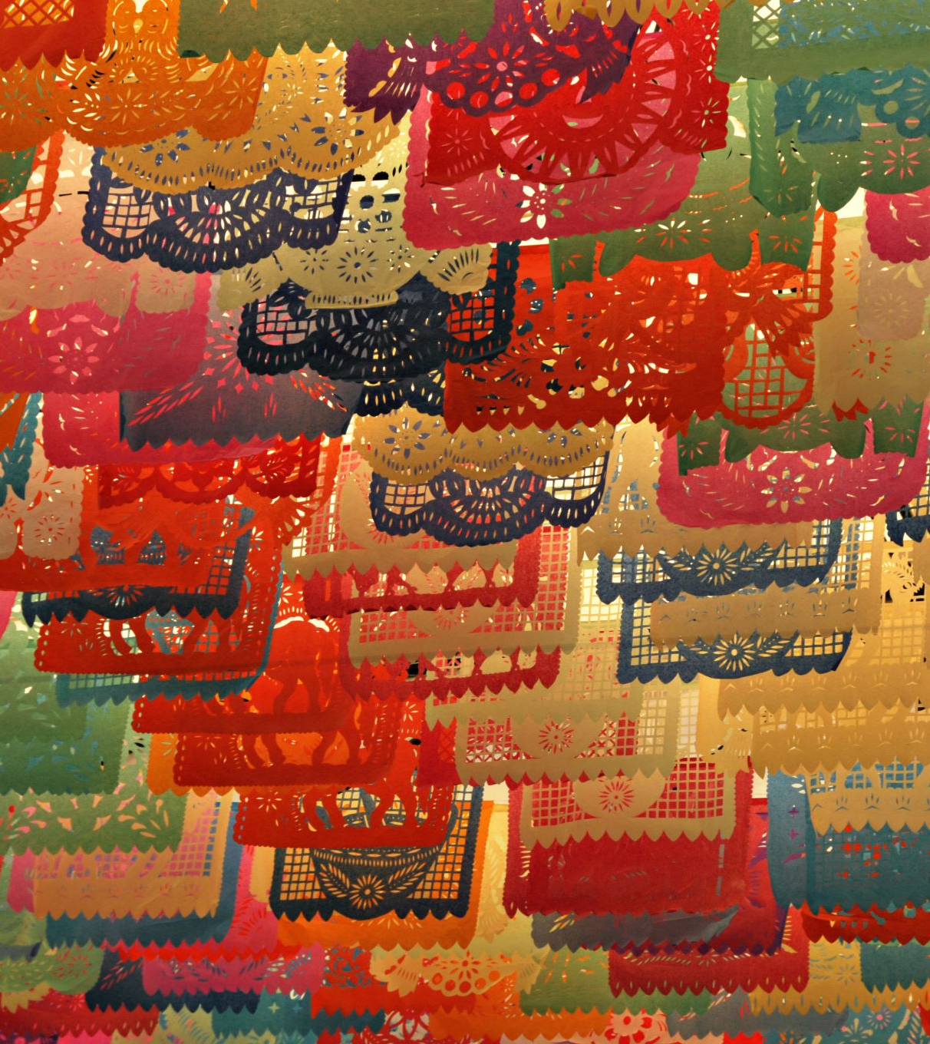
Key Take Aways
A Working Definition of Cultural Organizing
Understanding that cultural organizing isn’t just an add-on, but a core strategy that harnesses art, story, ritual, and memory to shift power and build resilient movements.

Slide 22
Take Aways continued
The Five Pillars of the KFTC Cultural Organizing Toolkit
  Indigeneity & Ancestral Wisdom
  Spirituality & Ritual
  Storytelling & Oral Tradition
  Artistic Expression & Symbols
  Community Memory & Archive
  *Recognize how each pillar offers specific methods and entry points for chapter work.

Slide 23
Take Aways continued
The Power of Artifacts
Personal and regional artifacts carry stories of resilience, belonging, and memory—serving as catalysts for deep connection and collective imagination.
Experiential Practice Matters
Hands-on sharing in small groups surfaces rich insights and builds empathy, turning abstract concepts into lived practice.

Slide 24
Take Aways continued
Collective Dreaming Opens New Possibilities
Using panel Q&A and group dreaming to envision concrete next steps for embedding cultural strategies in your chapter’s campaigns and actions.
Tools for Ongoing Engagement
The draft toolkit is just the start—to continue co-creating and refining these cultural practices.

Slide 25

Summary
In short, cultural organizing is the pathway forward when we believe that shifting hearts and imaginations is inseparable from shifting policies and power.

Slide 26
Timeline for Toolkit

Slide 27
Next Steps & Commitments
Possible action items:
  Join the KFTC COT Workgroup
    Share action page or QR Code here
  Brainstorm and pilot one cultural activity in your next chapter meeting
  Connect with others who have done cultural organizing to exchange ideas

Slide 28
Thank you for joining us!
May we all be well!

