Slide 1
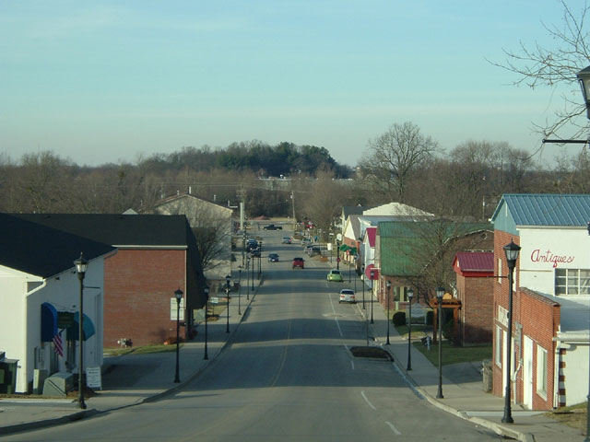
Local Option Sales Tax
Presentation to Kentuckians For The Commonwealth
Jefferson County Chapter
December 11, 2013

Slide 2
KFTC’s Tax Justice Campaign
Notes:
What we want
What our work looked like…started with the EITC in the late 90s. Realized we need revenue reform. Developed a set of principles that we use to create and evaluate tax policies:
Principles. Fair, adequate, well-being of Kentuckians, sustainable.
Examples of when we’ve stuck to these principles, and the upshot: KY is being described as a donut hole in the world of tax policy. We’ve always had a standard out there, something to aspire to. That’s shaped so much of the public conversation.

Slide 3
KFTC’s Principles of Tax Reform
KFTC leaders developed these principles to create and evaluate tax policy:
Fair
Adequate
Supportive of the well-being of Kentuckians

Slide 4
Notes:
workshops

Slide 5
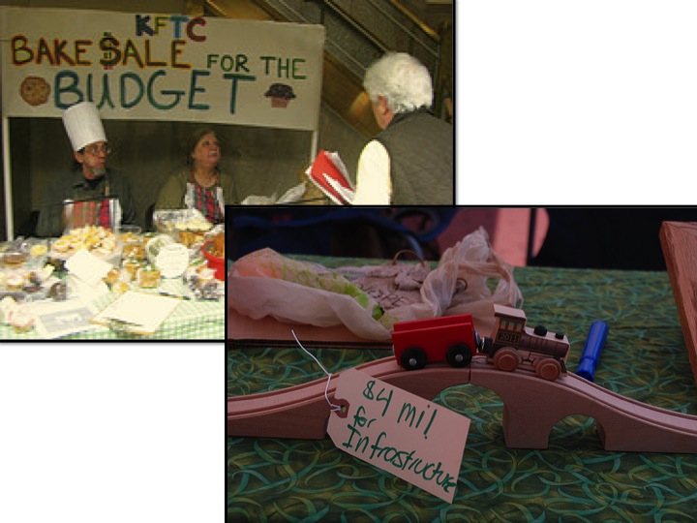
Notes:
Bakesale, yardsale, and quilting

Slide 7
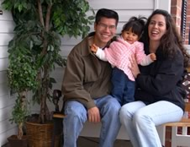
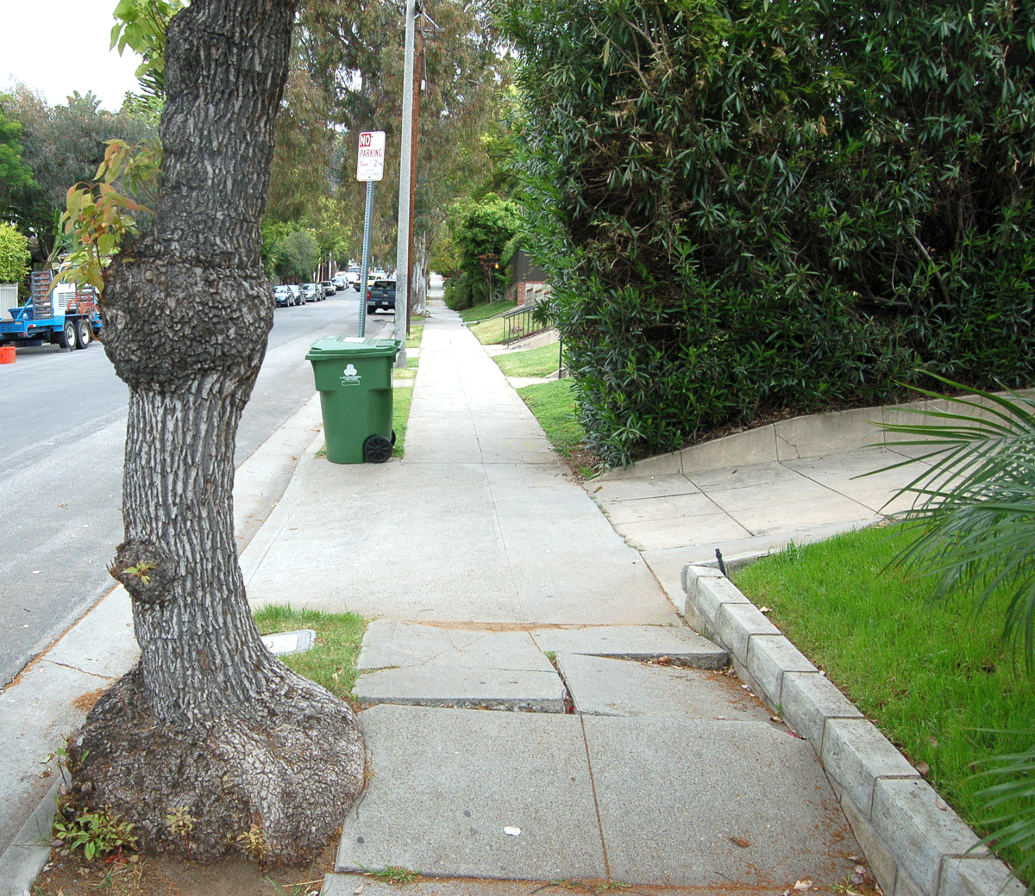
Importance of Kentucky local government

Slide 8
Local governments have challenges generating the revenue they need
Constitutional & statutory limits
Property tax limits
Limits on types of taxes they can levy
Limit on general revenue sharing
Other issues
Role of business tax incentives
Lack of a commercial & business base needed to make occupational & sales taxes viable
Loss of taxes due to industry declines

Slide 9
Kentucky’s property taxes are low
$21 in state & local property tax revenue per $1,000 in state personal income (2009-2010)
42% lower than US average of $36
Ranks Kentucky 45th among states
Source: Computed from Census Bureau Census of Governments

Slide 10
Real Property Tax Rates in Louisville/Jefferson County Have Fallen Dramatically
35% decline in Louisville and 42% decline in Jefferson County since 1978.

Slide 11
Business Tax Incentives Another Challenge
Abatement of 1% occupational tax part of many tax incentives
Growth of tax increment financing
Cities can exempt occupational & property taxes of new manufacturing facilities for up to 5 years
126 large companies in
Jefferson County have
received final approval for
tax incentives according to
state database

Slide 12
Sales Tax is a Regressive Tax
Source: Institute on Taxation and Economic Policy

Slide 13
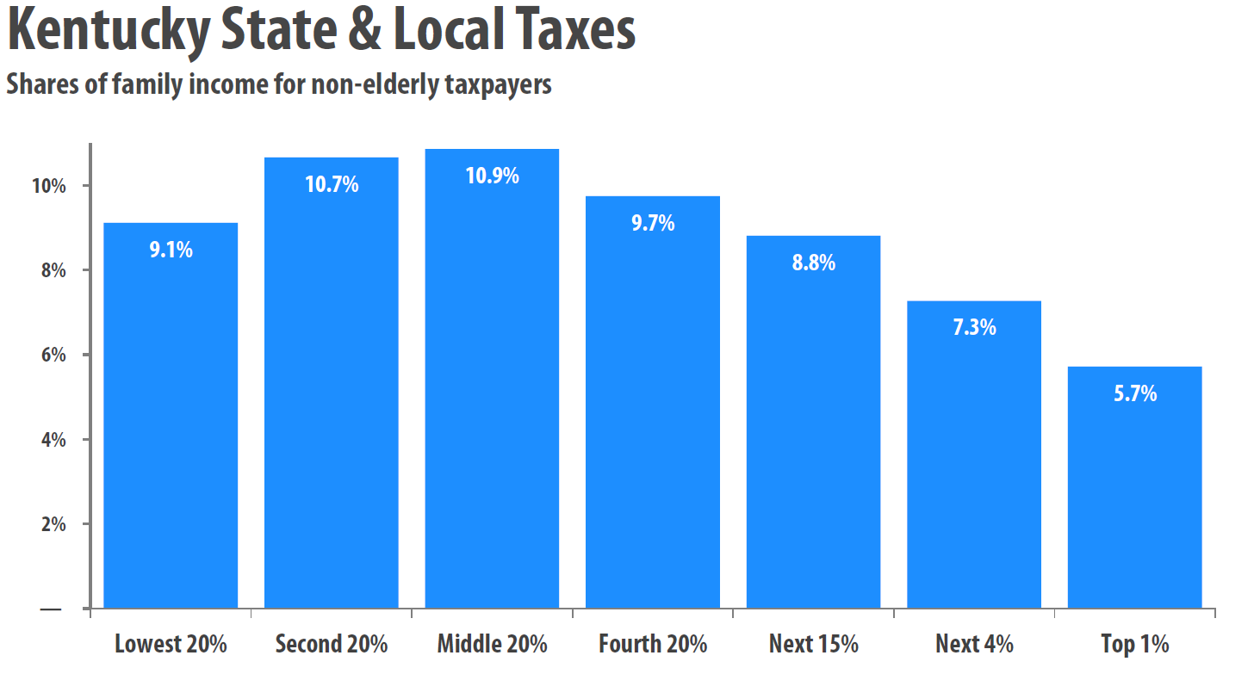
Who Pays?
Source: Institute on Taxation and Economic Policy

Slide 14
Other Challenges with Local Option Sales Taxes
Not deductible against federal taxes like occupational tax & property tax
Limited growth of sales tax revenue because not modernized
Loss of state sales tax revenue because of border & consumption effects
Not a solution for localities without a sufficient commercial base
Problem with earmarking for specific projects

Slide 15
Sales Tax Base is Eroding
Source: KCEP analysis of OSBD, BEA data

Slide 16
Context Needed for Local Option Sales Tax
Need for a comprehensive tax reform package that includes sales tax modernization & refundable EITC to address fairness
Can’t be a tax swap or include a tax offset—that would simply shift responsibility

Slide 17
Considerations for local taxation
Broad view of the issue of local taxation should be taken
Tax fairness and revenue sustainability must be part of the conversation
Need to address decline in the property tax
Recall provisions
Create a circuit breaker & amend homestead exemption
Greater scrutiny & disclosure of tax breaks

