Slide 1
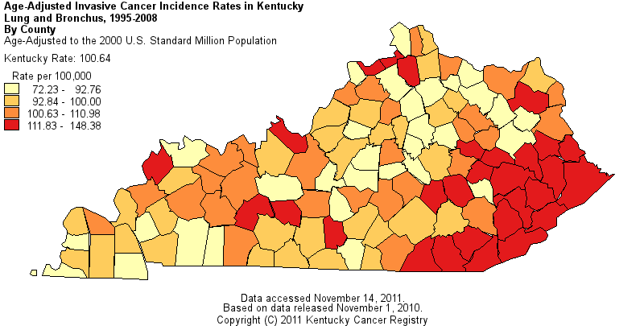
Investigating the Geographic Distributions of Lung Cancer Incidence and Trace Elements Exposure in Appalachian Kentucky
W. Jay Christian, MPH

Slide 2
Outline
Lung Cancer and Smoking in KY
Spatial Statistical Analysis of Lung Cancer
Lung Cancer, Trace Elements, and Coal Mining
New Federally-Funded Case-Control Study in SE Kentucky

Slide 3
Lung Cancer in KY
Among the highest incidence rates in the U.S.
100.8 cases per 100,000 residents (KCR 2004-2008) compared to about 75.2 per 100,000 in the U.S. (SEER 2004-2008)
Within KY, the highest rates are in the southeast, Appalachian portion of the state
Several counties over 125 per 100,000, and a few over 140 per 100,000 (KCR 2004-2008)

Slide 4
Smoking in KY
Among the highest smoking rates in the U.S.
25.6% of adults versus 17.9% nationwide (BRFSS 2009)
Over 30% until about 2003-2004
Smoking rates are highest in the Appalachian region
30.1% in Appalachian counties versus 23.7% in the rest of KY (BRFSS 2009)

Slide 5
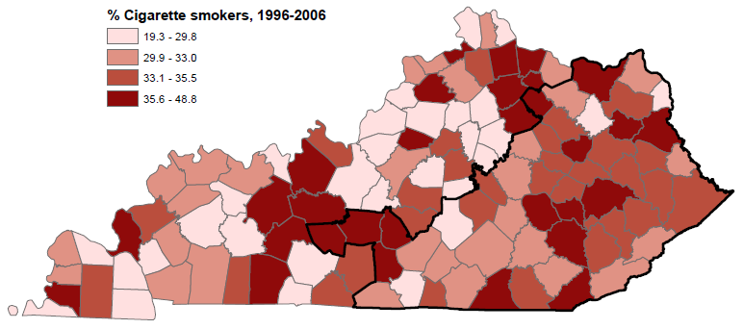
Smoking & Lung Cancer
(Data: BRFSS)

Slide 6
Spatial Scan Statistic
Kulldorff (1997)

Slide 7
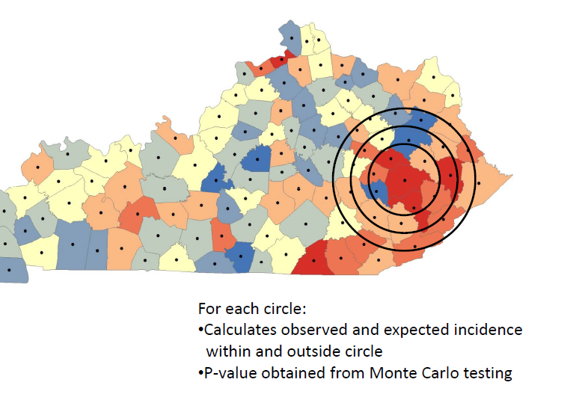
Spatial Scan Statistic

Slide 8
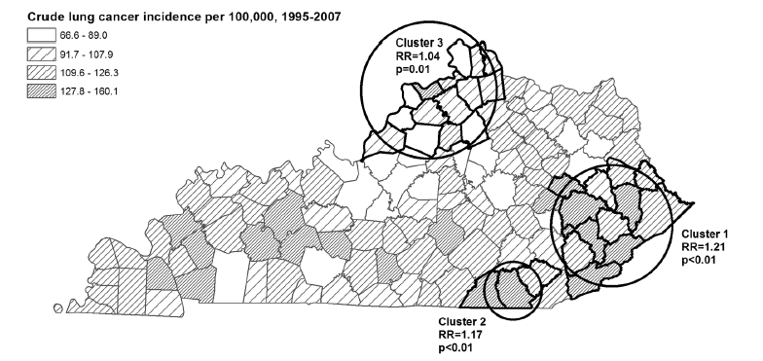
SaTScan Results
Christian et al. (2011)

Slide 9
Other Considerations…
What about current smoking instead of lifetime smoking rates?
Results of analysis using current smoking rates were similar
What about the influence of occupation?
Results of analysis using women only were similar
What about smoking intensity? Do smokers smoke more in SE KY?

Slide 10
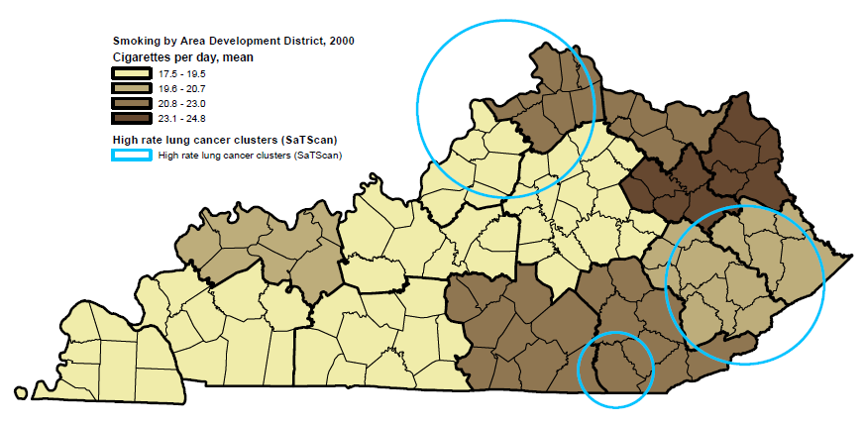
Smoking Intensity
(Data: BRFSS)

Slide 11
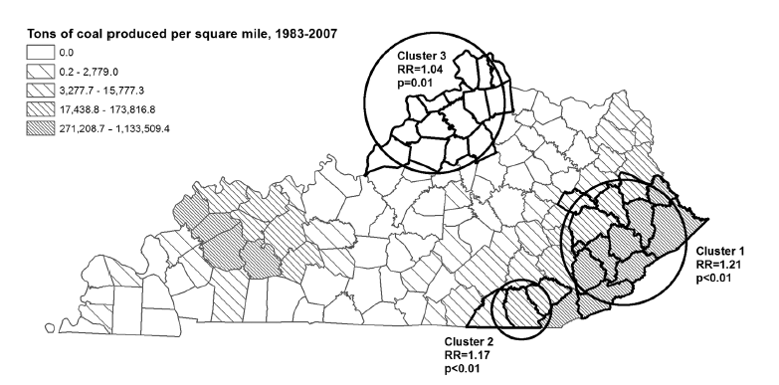
SaTScan Results & Coal Mining
Christian et al. (2011)

Slide 12
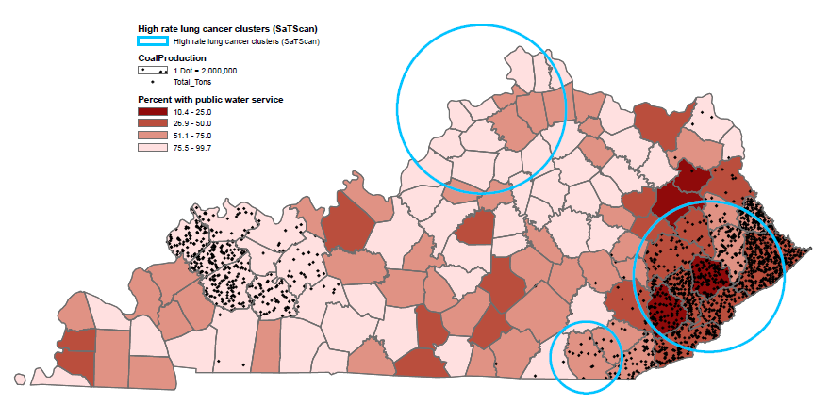
Public Water Utility Access
(Data: KDOW, MSHA)

Slide 13
Trace Elements & Lung Cancer
Exposure to certain heavy metals and trace elements in drinking water can increase lung cancer risk
Arsenic (As)
Nickel (Ni)
Cadmium (Cd)
Chromium as Cr(VI)
Eastern KY coal has relatively high levels of As in associated pyrite
Some evidence of elevated As in private well water from the region (Shiber 2005)

Slide 14
Toenail Study
Convenience sample of toenails from CRC cases and controls from a previous study
Samples from Jefferson County, as well as several Appalachian counties
Concentration of As in toenails from Appalachian counties found to be higher than in Jefferson Co.
Concentrations consistent with low-moderate exposure to As in drinking water
Johnson et al. (In Press)

Slide 15
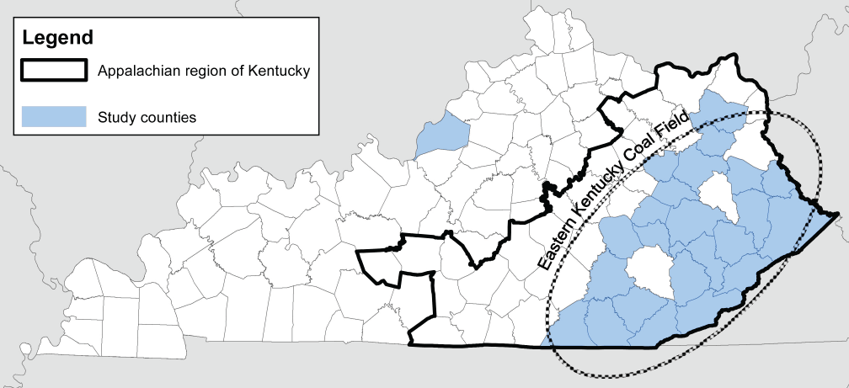
Toenail Study
Johnson et al. (In Press)

Slide 16
New Case-Control Study
“A population-based case-control study of lung cancer in Appalachian Kentucky: The role of environmental carcinogens”
This study will collect:
Biological specimens and environmental samples from lung cancer patients and controls
Urine, blood, hair, toenails
Tap water, household dust, radon test kit
Latitude/longitude of residence
Other data via in-person questionnaire
Smoking history and current smoking behavior
Residential history
Occupational history
Family history of cancer
More…
This study will also fund four pilot projects that will utilize samples and other data

Slide 17
Pilot Project
“Spatial analysis of trace elements exposure and lung cancer risk”
Analysis of urine samples to assess the concentration of:
Arsenic, nickel, chromium, zinc, copper, selenium, cadmium, lead, magnesium, iron, and cobalt
Arsenic species/metabolites: MMA, DMA(V), DMA(III), As(III), As(V), arsenocholine, arsenobetaine
Mapping the concentrations of these trace elements using latitude/longitude to identify any patterns in exposure or As metabolism
Spatial analytic techniques including:
Spatial scan statistics
Kriging
Spatial autocorrelation

Slide 18
Pilot Project
Spatial scan statistics
Could identify clusters of high trace element exposure
Kriging (or similar techniques)
A method for geostatistical interpolation available in ArcGIS
Estimates values at unobserved locations from observations at known locations
Spatial autocorrelation
Multiple techniques available in ArcGIS
Moran’s I
Getis-Ord Gi*
Reveals whether high values or low values tend to cluster

Slide 19
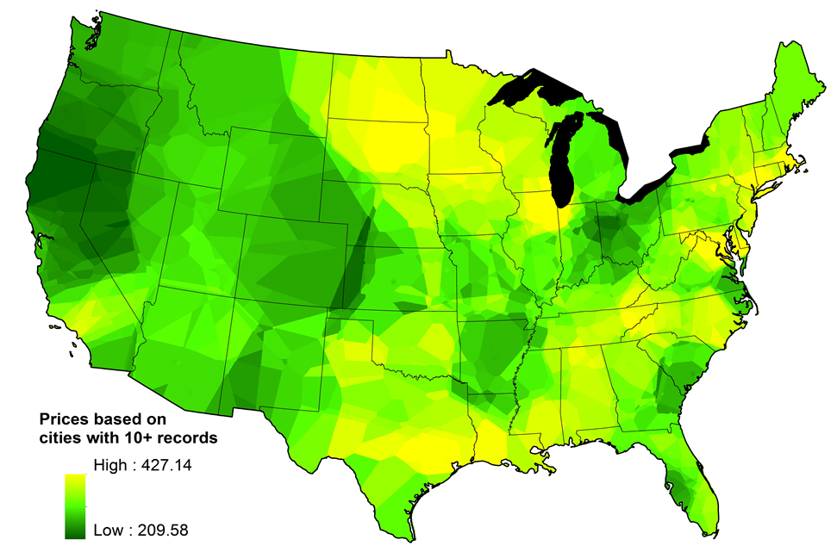
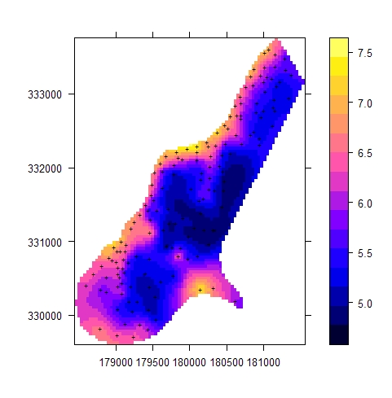
Kriging
Marijuana prices from floatingsheep.com
Zinc in soils from spatial-analyst.net

Slide 20
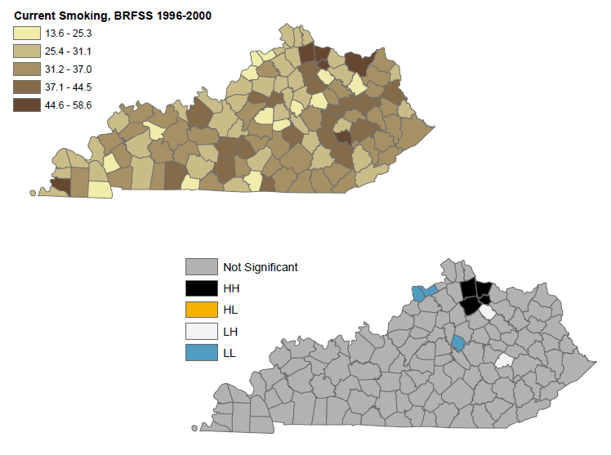
Anselin Local Moran’s I

Slide 21
References
Christian WJ, Huang B, Rinehart J, Hopenhayn C. Exploring geographic variation in lung cancer incidence in Kentucky using a spatial scan statistic: Evidence of elevated risk in the Appalachian coal mining region. Public Health Reports; 126: 789-796.
Johnson N, Shelton BJ, Hopenhayn C Tucker TT, Unrine JM, Huang B, Christian WJ, Shi X, Li L. 2011. Concentrations of arsenic, chromium, and nickel in toenail samples from Appalachian Kentucky residents. Journal of Environmental Pathology, Toxicology and Oncology: In Press.
Kulldorff M. 1997. A spatial scan statistic. Communications in Statistics: Theory and Methods; 26: 1481-96.
Shiber JG. 2005. Arsenic in domestic well water and health in Central Appalachia, USA. Water, Air, and Soil Pollution; 160: 327-41.

Slide 22
Thank you.
W. Jay Christian, MPH
Staff Epidemiologist
Markey Cancer Control Program
jchrist@kcr.uky.edu
PhD Candidate
Department of Geography
jay.christian@uky.com

